Slide 1



Project : Water Quality Prediction
Name : Thoriya Drashvi
AICTE Internship Student ID : STU67e905719910c1743324529

Slide 2

Learning Objectives
Understand how AI/ML can be used to solve real-world problems like water pollution.
Learn how to clean and prepare data for a machine learning model.
Build a simple prediction model using historical data.
Create a basic web application to make the model usable for others.
Gain hands-on experience with tools like Streamlit, pandas, and scikit-learn.
GOAL
Source :
www.freepik.com/

Slide 3
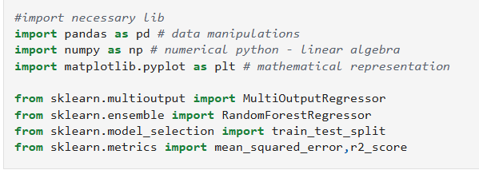
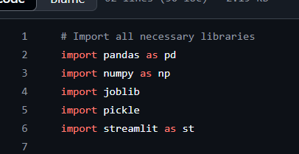
Tools and Technology used
As a beginner, I explored and used:
Python – The main language for everything.
pandas & numpy – For data cleaning and manipulation.
scikit-learn – To train the machine learning model.
joblib & pickle – To save and load the model.
Streamlit – To create a simple and interactive web app.
matplotlib – For visualizing the results.
GitHub – To host and share my project online.

Slide 4
Methodology
I started by understanding the dataset – it had different pollutant levels over years.
Cleaned and prepared the data, and converted station IDs using encoding.
Trained a regression model to predict 9 different pollutants.
Tested the model and saved it for reuse.
Designed a Streamlit web app where users can input the year and station ID.
When they click "Predict", it shows pollutant levels clearly in numbers.

Slide 5
Problem Statement:
How can we predict water pollution levels quickly without expensive lab tests?
Environmental monitoring usually takes time and money.
Predicting pollution levels using machine learning can help take faster actions.
My goal was to build a beginner-level system that shows this is possible.

Slide 6
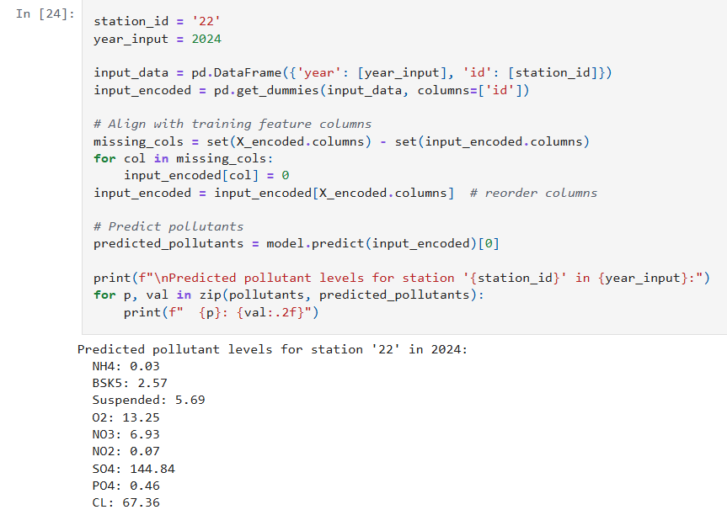
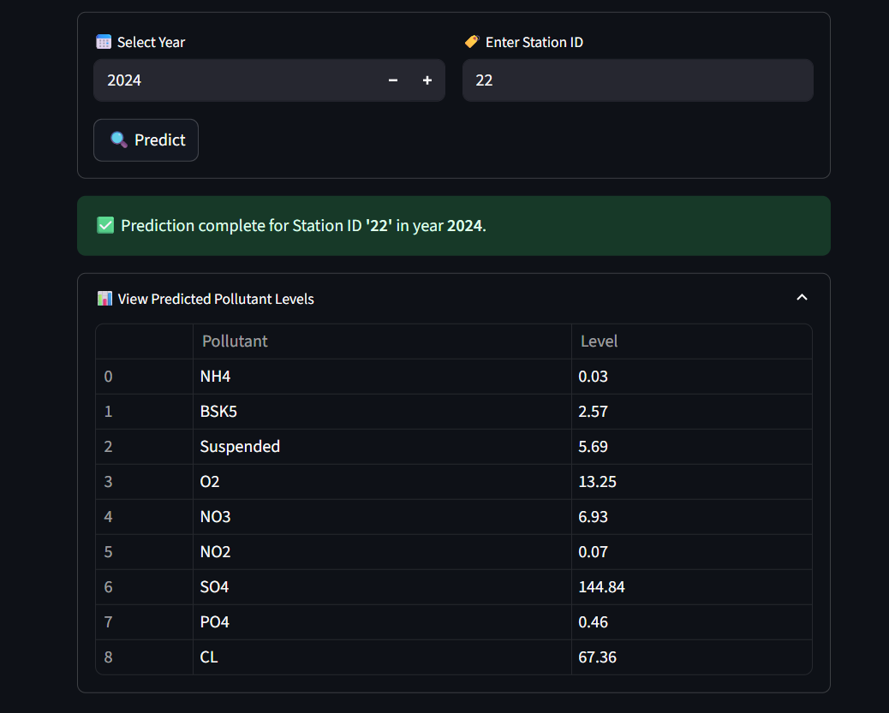
Solution:
I trained a model using past data to learn patterns.
The model predicts pollutants like O2, NO3, SO4, etc., based on just the year and station ID.
I built a friendly web app using Streamlit where anyone can enter values and get instant predictions.
It's not perfect, but it's a great start for learning how AI/ML can solve environmental problems.
In Source code Output
On Deployment Output

Slide 7
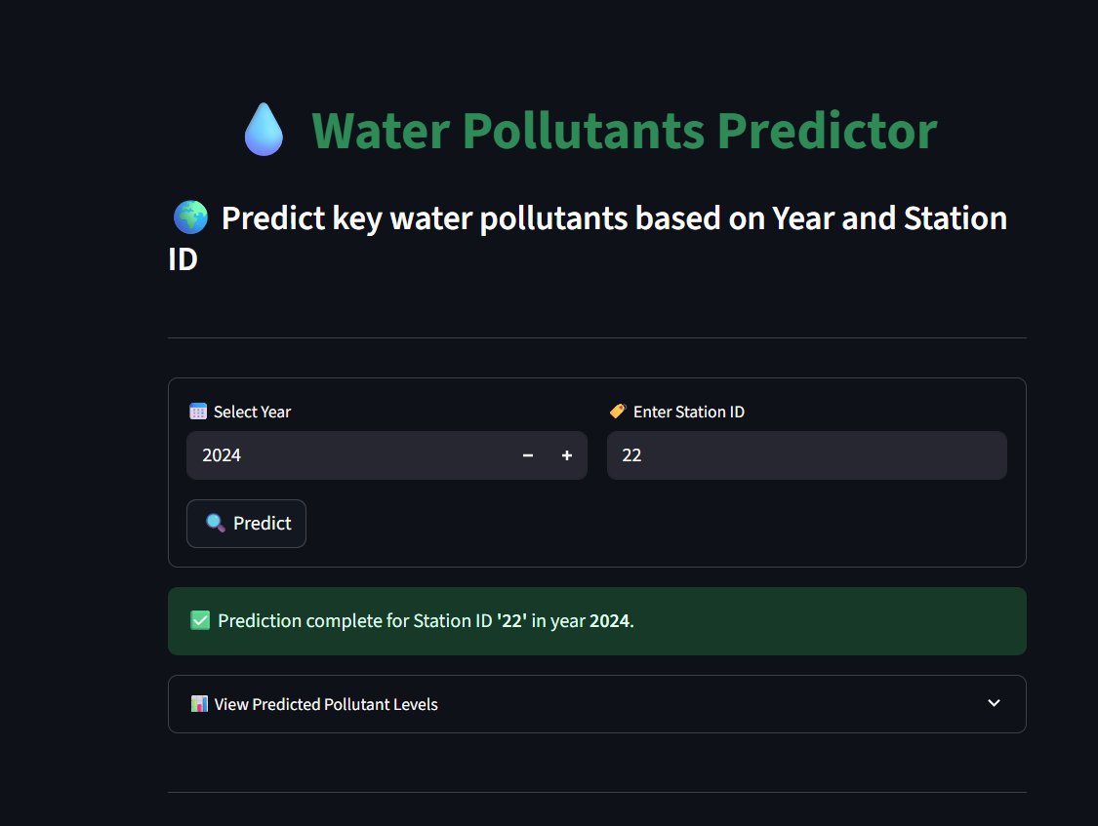
Screenshot of Output:

Slide 8
Conclusion:
This was my first ML project and I learned a lot — from cleaning messy data to making a real app!
It helped me understand the full flow: Data → Model → App.
It felt great to build something that could be useful in solving pollution problems.
In the future, I’d love to:
1.Add live data
2.Improve model accuracy
3.Try adding map-based features
GitHub Link : https://github.com/Drashvi/WaterQualityPredictionMLProject

Slide 9
THANK YOU !

